Slide 1
Reproducing a Hybrid Neuro-Symbolic Framework for COVID-19 CT Classification
An AGCA Model Implementation Study
Umra Amir · Zain Ul Abideen · Nageen Ahsan
Department of Artificial Intelligence, FAST-NUCES Islamabad, Pakistan
Deep Learning Project Presentation

Slide 2
Presentation Outline
Motivation & Problem Statement
Results & Analysis
01
05
Why COVID-19 CT analysis? Why domain shift matters?
96.91% accuracy, AUC 0.994–1.000, Grad-CAM
Related Work
Ablation & Cross-Domain
02
06
Deep learning, Symbolic AI, Domain Adaptation
Symbolic gain, domain shift analysis
Datasets & Preprocessing
Limitations & Future Work
03
07
Four public CT datasets, 11,000 images
Missing DAFA, U-Net, deformable convolutions
AGCA Architecture
Conclusion
04
08
Attention backbone, symbolic head, uncertainty fusion
Validated base paper under constrained compute

Slide 3
Motivation & Problem Statement
🏥 Clinical Challenge
Key Claims to Validate
AI models achieve >99% accuracy on curated single datasets but fail in real hospital deployment due to domain shift (scanner models, protocols, patient demographics).
97.7%
0.996
0.996
Avg Accuracy
AUC-ROC
AUC-ROC
🔍 Base Paper
Musanga, Chibaya & Viriri (2026) proposed a hybrid neuro-symbolic framework combining ResNet-50, adversarial domain adaptation (DAFA), and symbolic clinical rules for COVID-19 CT classification.
4 Datasets
Hybrid AI
Hybrid AI
Cross-domain
CNN + Symbolic
CNN + Symbolic
🎯 Our Goal
Reproduce and validate the core architecture on Google Colab (Tesla T4) under limited compute, using the same four public datasets.

Slide 4
Datasets & Preprocessing
Dataset | Total Images | Format | Classes | Our Split (N≈11K)
COVID-CT-MD | 43,322 | DICOM | Normal / COVID / CAP | ~8,868
Kaggle Lung CT | 8,439 | PNG/JPG | Normal / COVID | ~1,942
BMIC2 | 746 | PNG/JPG | Non-COVID / COVID | ~130
MosMedData | 148 | NIfTI | Normal / COVID | ~60
Class Distribution (11,000 samples)
Preprocessing Pipeline
23.8%
59.2%
16.9%
1. DICOM → invert MONOCHROME1 | NIfTI → middle axial slice
2. Resize all to 224×224 px → 3-channel RGB
3. Augment: flip, ±15° rotation, ±20% brightness/contrast
4. WeightedRandomSampler + class-weighted cross-entropy loss
5. 80/10/10 stratified train/val/test split
2,620
Normal
6,516
COVID-19
1,864
Pneumonia/CAP

Slide 5
Train/Val/Test
Class Distribution (11,000 samples)
80%
10%
10%
8,800
Training
1,100
Validation
1,100
Testing

Slide 6
AGCA Hybrid Model Architecture
ResNet-50
Attention Gate
Classifier Head
Symbolic Indicator
Rule Engine
Prediction
3 Classes

Slide 7
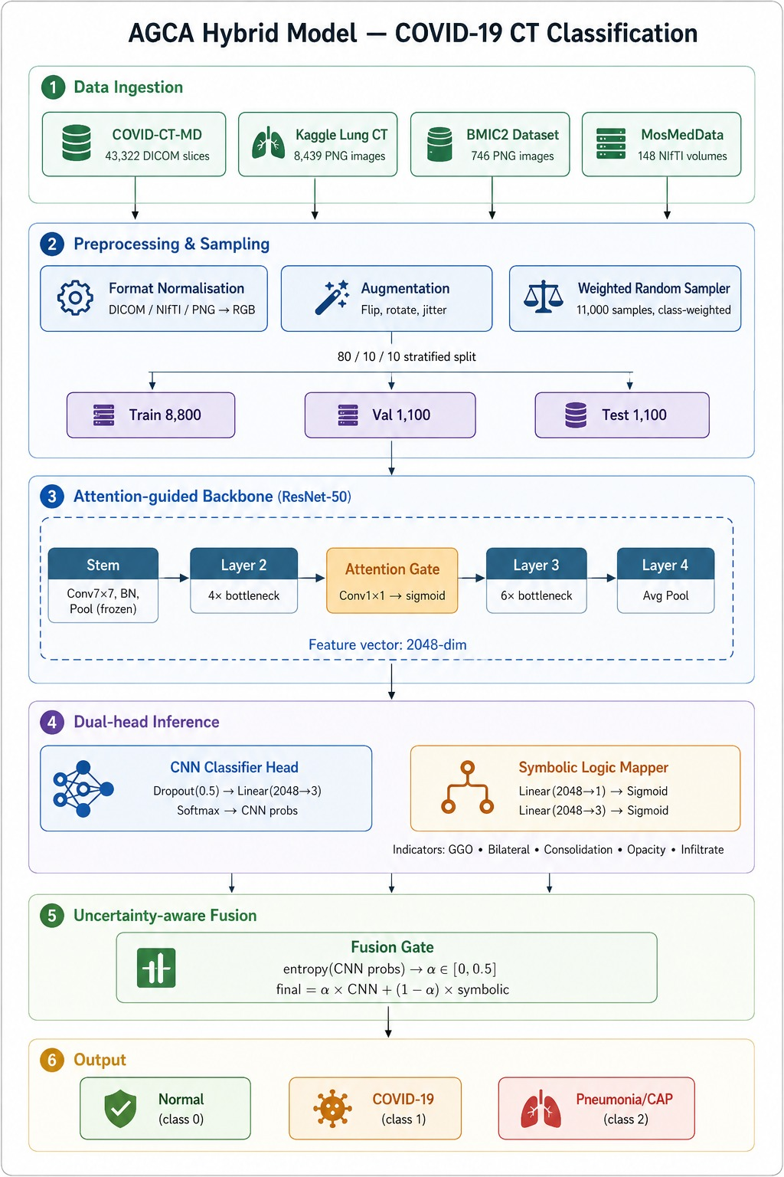

Slide 8
Training Configuration & Dynamics
Optimizer | Adam
Learning Rate | 1e-4
Weight Decay | 1e-4
Batch Size | 32
Epochs | 10 (best @ 3)
LR Scheduler | Cosine Annealing
Grad Clip | 1.0
λ indicator | 0.3
Image Size | 224×224 px
GPU | Tesla T4 (Colab)
Per-Epoch Training History
Epoch | Loss | Val Acc | Val F1
01 | 0.0480 | 96.09% | 0.9605
02 | 0.0374 | 96.91% | 0.9691
03 ★ | 0.0303 | 97.55% | 0.9755
04 | 0.0365 | 97.18% | 0.9718
05 | 0.0287 | 97.00% | 0.9700
06 | 0.0407 | 96.45% | 0.9647
07 | 0.0475 | 94.64% | 0.9469
10 | 0.1303 | 92.00% | 0.9201
★ Best checkpoint saved at Epoch 3 (Val Acc = 97.55%). Model converged quickly; cosine annealing caused oscillation in later epochs.

Slide 9
Overall Test Set Performance
96.91%
0.994–1.000
0.9691
97.7%
Test Accuracy
AUC-ROC Range
Weighted F1
Base Paper Acc
Comparison vs. Base Paper
Per-Class F1-Score
Metric | Ours | Base [1]
Accuracy | 96.91% | 97.7%
Precision | 96.92% | 97.4%
Recall | 96.91% | 97.9%
F1-Score | 96.91% | 97.6%
AUC Normal | 0.994 | 0.996
AUC COVID | 0.995 | 0.996
AUC Pneumonia | 1.000 | 0.996
Normal
94%
COVID-19
98%
Pneumonia/CAP
99%
Normal cases score slightly lower (F1=0.94) as early-stage COVID-19 shares subtle CT features with healthy lung parenchyma.

Slide 10
Cross-Dataset Evaluation & Ablation Study
Cross-Dataset Generalization
Ablation Study
Dataset | N (test) | Accuracy | F1
COVID-CT-MD | 887 | 96.96% | 96.96%
Kaggle | 194 | 97.94% | 97.83%
BMIC2 | 13 | 76.92% | 76.64%
MosMedData | 6 | 66.67% | 80.00%
ResNet-50 Baseline
65.00%
AGCA Visual Only
96.45%
AGCA Full Hybrid
96.91%
Domain Shift Insight
Large, well-represented datasets: 96–97% accuracy
Small, out-of-domain: drops to 67–77%
BMIC2 (13 samples), MosMedData (6 samples) → noisy estimates
Each misclassification = 8–17% accuracy shift
PCA confirms separate feature clusters for BMIC2 & MosMedData
Symbolic Fusion adds +0.46% accuracy gain (modest because indicator targets are synthetic from class labels, not radiologist-verified annotations).
MosMedData has highest feature distance from Kaggle (0.08 on domain discrepancy heatmap) — requiring the most adaptation.

Slide 11
Grad-CAM Explainability & Domain Analysis
Grad-CAM Analysis
PCA Domain Analysis
Applied to: layer4[-1] (final conv block) Findings: • Model consistently focuses on lung parenchyma • Peripheral regions show highest activation (GGO hallmark) • Background (ribs, mediastinum) — minimal activation • Clinically meaningful patterns WITHOUT U-Net segmentation Significance: Warm colors (red/orange) = highest attention zones, confirming the model learned clinically relevant features, not confounders.
Feature Space Findings: • COVID-CT-MD (dominant): occupies large region • Kaggle: overlaps substantially with COVID-CT-MD • BMIC2 + MosMedData: cluster separately → explains lower cross-domain accuracy Domain Discrepancy Heatmap: Higher pairwise distance = more domain shift. MosMedData ↔ Kaggle shows max distance (0.08), validating the base paper's findings. Adaptation Embedding: Source (blue) → Target (red) → Adapted (green) features converging toward shared representation under adversarial alignment.

Slide 12
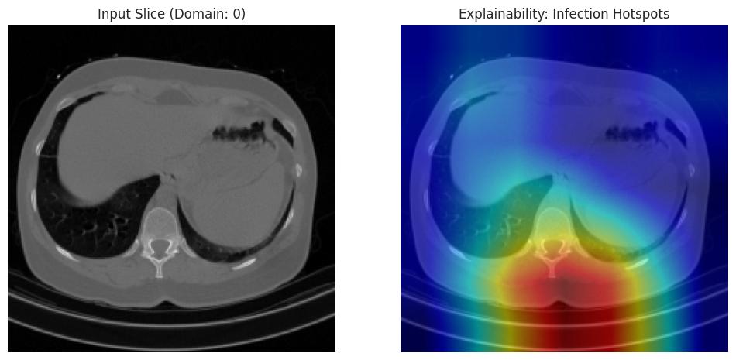
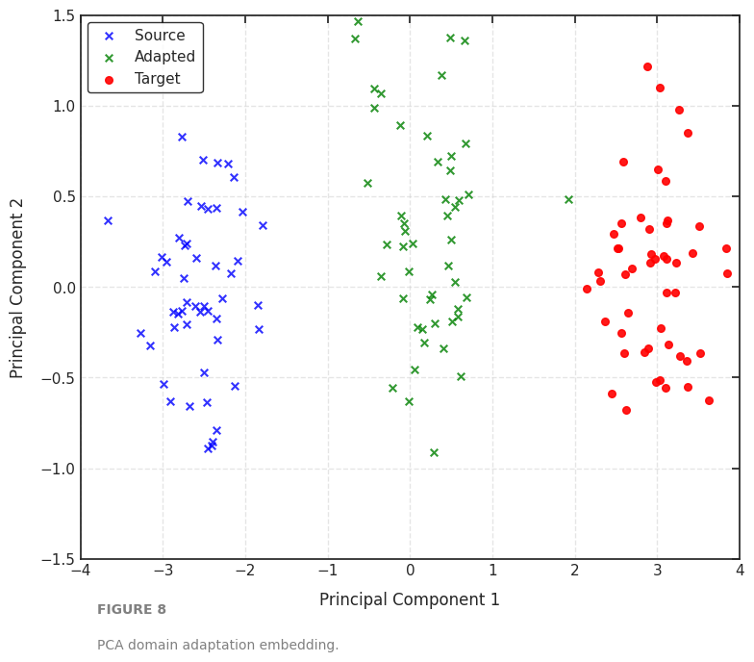

Slide 13
Limitations & Future Work
🔬 No U-Net Segmentation
🔄 No Formal DAFA
Most impactful missing component. Without lung masks, model exposed to confounding ribs/mediastinum → features may not generalize across scanners.
We approximated domain-adversarial adaptation. A proper gradient reversal layer would substantially improve BMIC2 & MosMedData performance.
⏱ Only 10 Epochs
📊 Tiny Test Subsets
Base paper trained 50 epochs with early stopping (patience=10). Our curves suggest the model had not fully converged — cosine annealing caused oscillation.
BMIC2 (13 samples), MosMedData (6 samples) — one error = 8-17% swing. Estimates are statistically unreliable for these domains.
Future Work: (1) U-Net segmentation preprocessing (2) Gradient reversal DAFA (3) Deformable convolutions (ADM) (4) 50+ epoch training (5) Prospective clinical dataset validation

Slide 14
Conclusion
✅ Core Validated
AGCA Hybrid Model achieved 96.91% accuracy & AUC 0.994–1.000, closely matching the base paper's 97.7% / 0.996 under heavily constrained compute (Tesla T4, 10 epochs).
🌐 Domain Shift Confirmed
Strong on large datasets (COVID-CT-MD: 96.96%, Kaggle: 97.94%). Performance drops on small out-of-domain sets, consistent with base paper findings.
🧠 Symbolic Fusion Works
Adds +0.46% accuracy with clinically meaningful Grad-CAM attention — even without radiologist-verified indicators or U-Net segmentation.
"This reproduction validates the hybrid neuro-symbolic approach as achievable under constrained conditions — domain adaptation remains the most critical path to clinical deployment."

